Slide 1
Setting KPIs and OKRs in your threat modeling program
Maximizing value through strategic goal setting

Slide 2
Agenda
01 – Introducing OKRs
03
02 – Setting objectives within Threat Modeling
06
03 – Sample Key Results
09
04 – Sample Key Performance Indicators
17
@2024 IriusRisk. All Rights Reserved

Slide 3
Threat Model Value
Threat Models
Threats
Value
What is the actual value of a threat model?
Value = Returns - Costs
Countermeasures
Reduced Risk

Slide 4
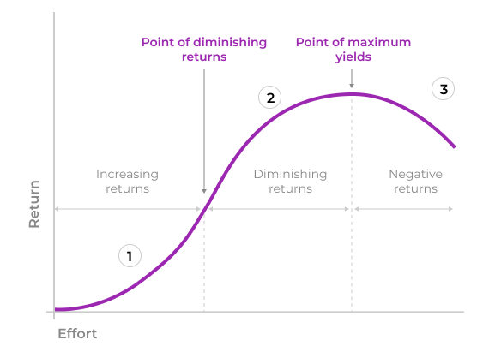
Diminished Marginal Returns
As the effort to create value (net return) increases the net value of the return is diminished over time.
Don’t read the fine print - Image liberated from https://uxmag.com/articles/law-of-diminishing-returns-design-and-decision-making
Notes:
SMART measurements
Specific
Measurable
Achievable
Relevant
Timely

Slide 5
Diminished Marginal Returns
Way too accurate
Full System Representation
As the effort to create value (net return) increases the net value of the return is diminished over time.
Net Security Change
Don’t read the fine print - Image liberated from https://uxmag.com/articles/law-of-diminishing-returns-design-and-decision-making
Notes:
SMART measurements
Specific
Measurable
Achievable
Relevant
Timely

Slide 6

“An Objective is simply what is to be accomplished. It should be a crisp, one-line statement that is meaningful, action-oriented, and, ideally, inspirational.”

Slide 7
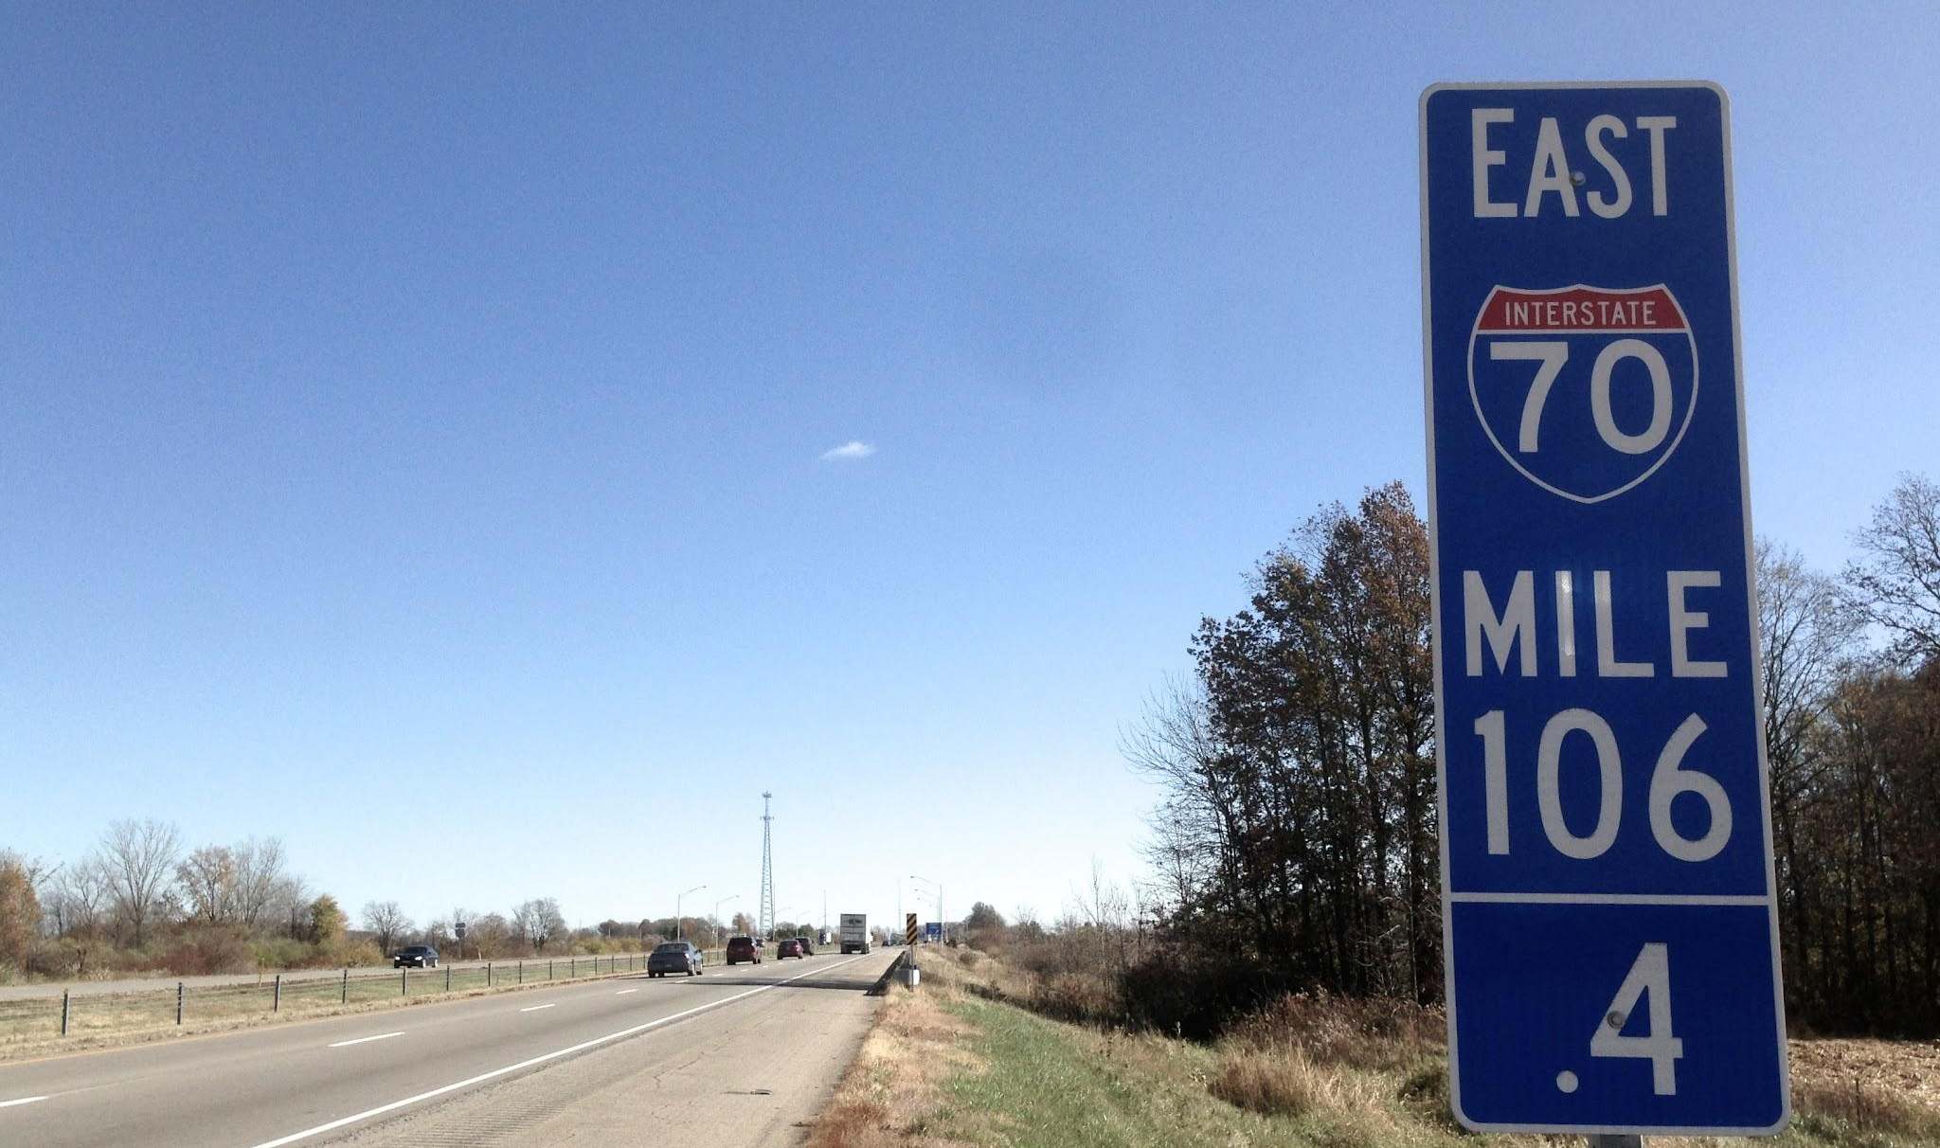
“Key Results should be specific and time-bound. They should be measurable and able to be assigned a grade at the end of the OKR cycle.”

Slide 8
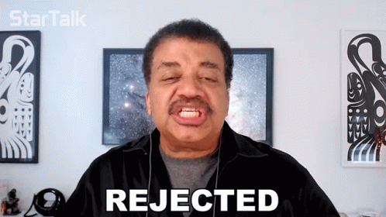
Key Results can be rejected or rewritten as new information becomes available.

Slide 9
Scenario
Organization needs to improve the overall efficiency and effectiveness of its threat modeling program.

Slide 10
Sample OKR
Objective - Grow threat modeling value per threat model
Key Result 1 - Achieve a 4 hour threat model across all v1 projects by implementing time blocking processes by end of Q2
Key Result 2 - All v2 projects are completed within an additional 2 hours by end of Q3

Slide 11
Scenario
Organization has a diverse group of threat modeling practitioners operating independently with wide variances in process, tooling, and outputs.

Slide 12
Sample OKR
Objective - Enhance Threat Modeling Process Efficiency
Key Result 1 - Achieve a 30% reduction in the time required for threat modeling activities across all projects by implementing standardized automation tools and processes by end of Q2
Key Result 2 - Increase the number of threat models completed per quarter by 20% through streamlined workflows and automation
Key Result 3 - Conduct a training program for development and security teams, resulting in a 50% training completion in threat modeling best practices by end of year

Slide 13
Scenario
Organization has a MATURE and business INTEGRATED threat modeling process that is further sustained by a threat modeling product.

Slide 14
Sample OKR
Objective - Strengthen Collaboration between Development and Security Teams
Key Result 1 - Facilitate cross-functional workshops between development and security teams, resulting in a 40% increase in collaborative threat modeling sessions by end of May.
Key Result 2 - Implement a feedback mechanism to address identified threats, aiming for a 50% reduction in the time taken to remediate critical issues by end of year.
Key Result 3 - Establish a regular communication channel between security and development teams, leading to a 30% improvement in information sharing related to emerging threats and vulnerabilities.

Slide 15
Scenario
Organization is NEW to FORMAL threat modeling and does not have a well defined process.

Slide 16
Sample OKR
Objective - Standardize Threat Modeling Practices
Key Result 1 - Establish a standardized threat modeling framework and documentation for all development teams, resulting in a 95% adherence to best practices.
Key Result 2 - Conduct regular reviews to ensure consistency in threat modeling outputs, with a goal of reducing variations by 80% across different projects
Key Result 3 - Develop and implement a metrics dashboard by end of month to track and report on threat modeling progress, ensuring visibility and accountability at all levels.

Slide 17

Why KPIs?
KPIs provide valuable point in time data into the pending success or failure of a process.

Slide 18

Sample Process KPIs
Adherence to Standardized Practices
Process incidents (failure indicator)
Percentage of Projects with Integrated Automation
Tickets created by integrations vs manual effort (trending indicators)
Feedback loop effectiveness
New Secure by default standards deployed from Threat Modeling process (success indicator)
Qty of Threats Created manually vs automatically

Slide 19

Sample Financial KPIs
Threat Model Review Cycle Time
How long does it take to complete a threat model (Time/Required CM) and (Time/Implemented CM)
Number of Threats Discovered Post-Release
Remediation Time for Critical Threats
Cost of Security Incidents

Slide 20

Sample Value KPIs
Number of Threat Models Created
Production Threat Models vs Pre-Production
Requires a description of done
Quantity of High Priority Prioritized Actionable Threats
Number of Threats Discovered Pre & Post-Release
Quantity of High Value Prioritized Actionable Countermeasures
Percentage of High-Risk Threats Mitigated

Slide 21
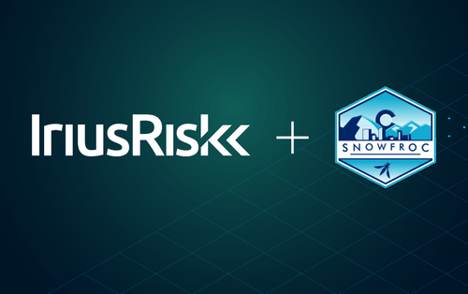
Questions?
What next?
See you at SnowFROC
iriusrisk.com/webinars

